Slide 1
SIDDHARTH INSTITUTE OF ENGINEERING & TECHNOLOGY
COMPUTER SCIENCE &ENGINEERING

Slide 2


Slide 3
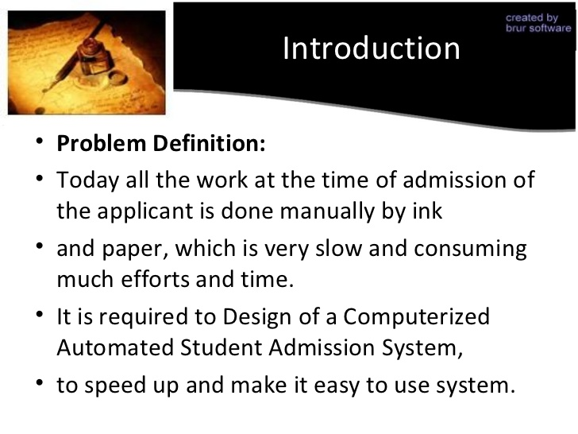

Slide 4
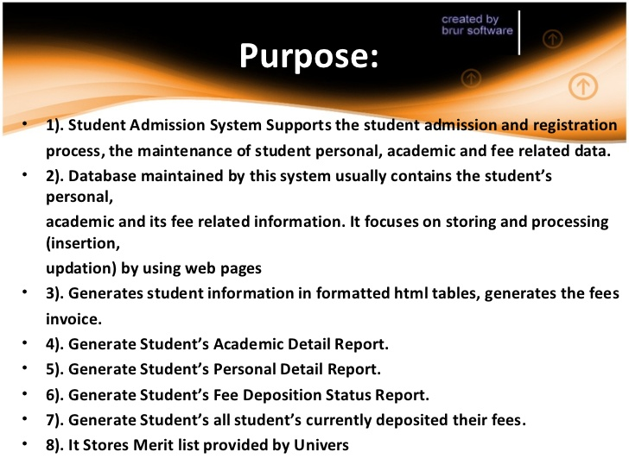

Slide 5
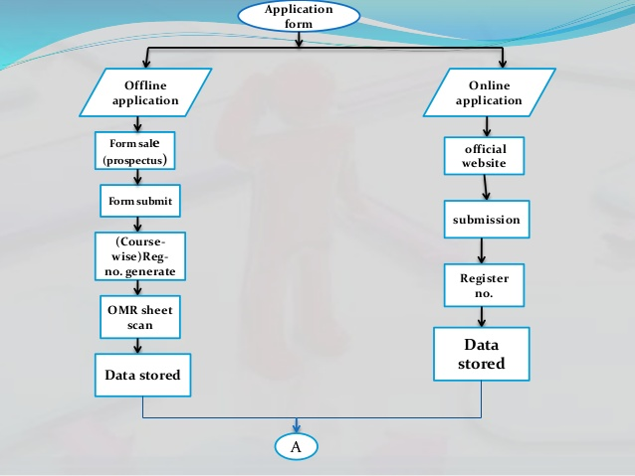

Slide 6
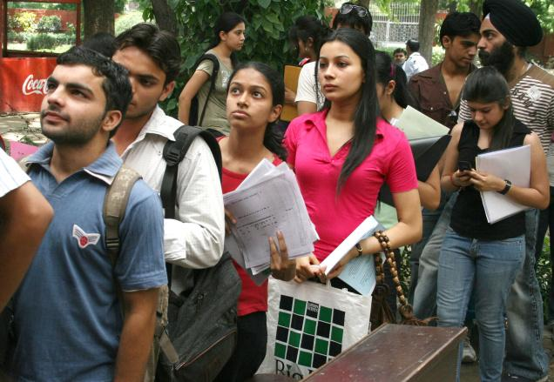

ADMISSION FORMAT
ONLINE
OFFLINE

Slide 7
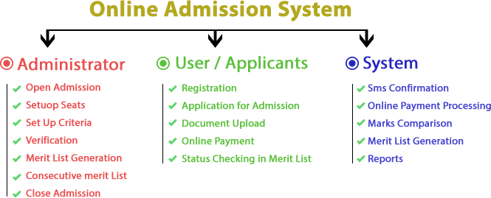

Slide 8
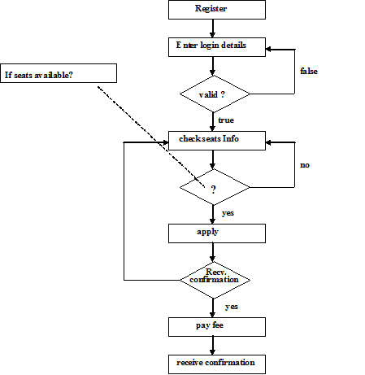
STEP BY STEP PROCESS

Slide 9


Slide 10
A.V. KRISHNA PRIYA, J.P. JAYANTHI M.D. KALPANA
PRESENTED BY:

Slide 11


